Slide 1




Hummingbird
OBJECT-MODEL BASED TEST SOLUTION
© 2013-2018 Huaxing YUAN, This presentation can be distributed under CC BY 3.0 license

Slide 2
"He that would perfect his work must first sharpen his tools“ - Confucius

Slide 3






Introduction
Hummingbird is a complete, extensible and easy to use solution for
API Testing
Performance Test
Test any kind of services with the help of the intelligent and object model based test editor.
Simulate load and measure how your web services can handle it.
Service Simulation
Test earlier and easier your application by simulating services that your system depends on.
Integrated Tools
Tools that developers / testers must have are also integrated in the solution
Test Automation
Build automated tests and run them on the fly
Integrate automated test in your DevOps pipeline.
Extensibility
Hummingbird is extensible.
Integrate your idea and let the software serves you better.

Slide 4

Introduction
The project contains following main components
Main application - to do all the things with
Hummingbird CLI - to run tests and service simulation from command line
Report Viewer – to view automated and performance test reports
All of them are based on an extensible Test and UI Framework

Slide 5
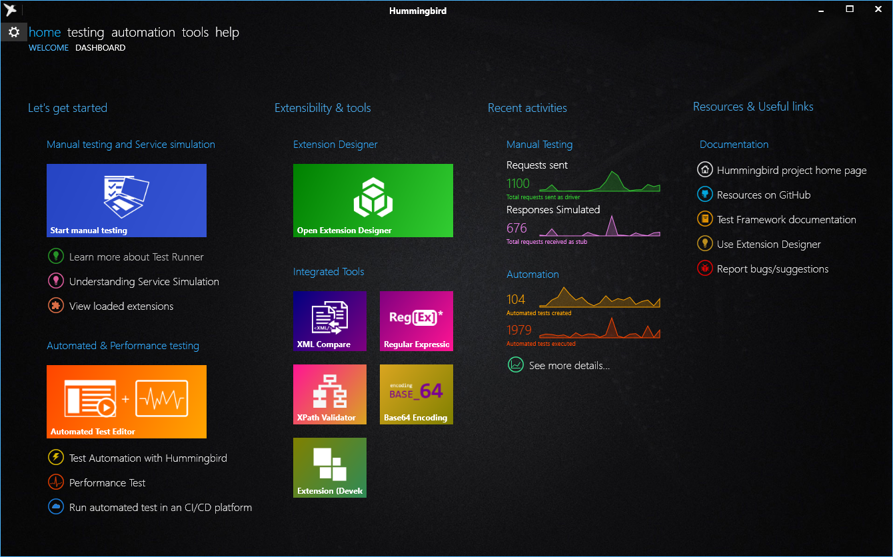
Hummingbird Application
The main application, that you can do all the things with
Test any kind of web services, including SOAP, REST and Non-HTTP services by extension
Simulate services that your system depends on
Build and run automated tests
Build and run service performance tests
View usage statistics
Import service description from WSDL and OpenAPI / Swagger 2.0

Slide 6
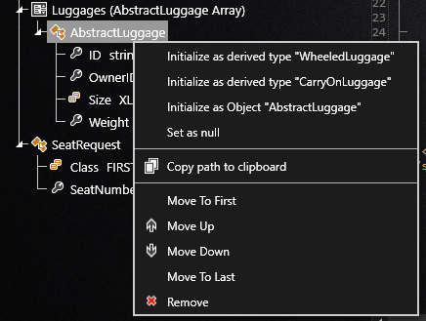
API Testing features
Services are organized and categorized.
Object Model based test editor
Uses advanced programming technology to generate test data based on Object models
Hides technical complexity of service protocols
Schema recognition, Value type detection and validation
Active Tracing
Test data is represented in its best way
Syntax highlighting
Document Folding
Schema based error checking
Variables and Test Environment management
Manages variables, credentials and parameters for each test environments
Example of schema recognition

Slide 7
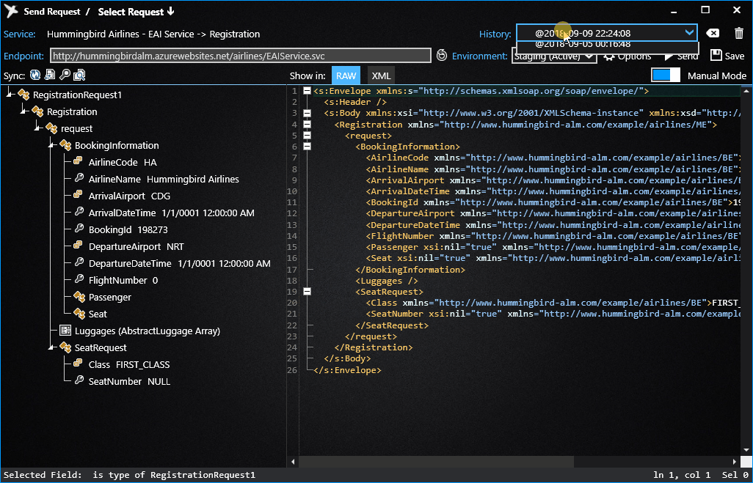
API Testing features - suite
Everything is archived
Anything sent and received by hummingbird is retained for prove of test and can be reused later.
Up to 20 recently used requests per service are kept (configurable).
You can save important requests as favorite to keep them permanently.

Slide 8
Real-time service simulation
Hummingbird can also simulate underlying services of your application.
With service simulation, you can set the reply of each underlying service in real-time in order to:
Simulate a normal or abnormal response
Simulate an error or a fault *
Simulate response time
Service simulation module is also available for test automation.
* Fault replies defined in SOAP protocol

Slide 9
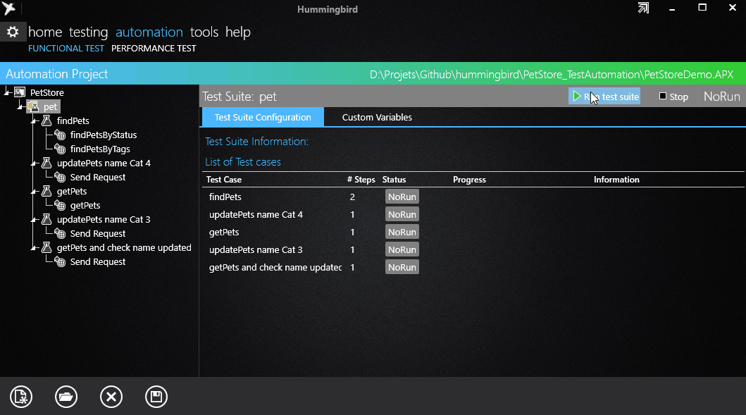
Test Automation
Hummingbird comes with an powerful automation engine.
That enables you to build automated test, run them and observe the test result in a graphical way.
Automated tests can also be executed with Hummingbird CLI and can be integrated with your favorite CI/CD platform.

Slide 10
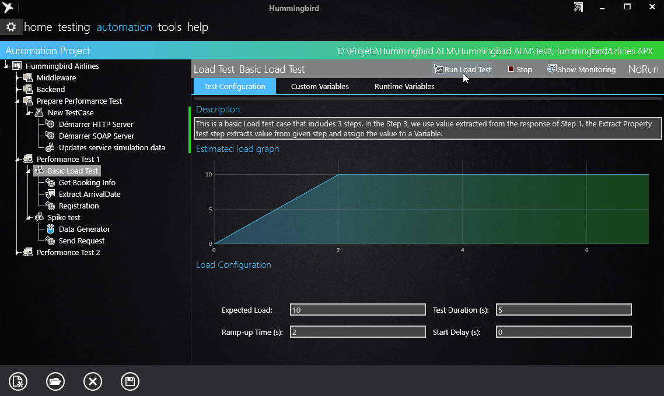
Service performance test
Performance test is perfectly integrated within an automation project
It can be run from command-line
Or in a CI/CD pipeline
Test configuration in real-time
Several built-in test models are provided
Load test
Stress test
Spike test
Or, your own performance test model

Slide 11
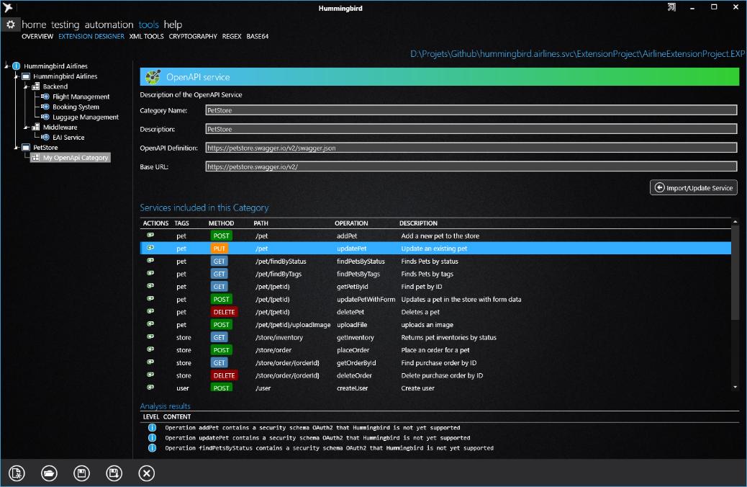
Extension Designer
With Extension Designer, you can import service descriptions from WSDL and OpenAPI (Swagger).
Service descriptions can then be compiled, packaged and loaded in Hummingbird quickly. Also these services description are versioned and shared.

Slide 12


Extensibility
Extensions can also be developed on top of Hummingbird Test Framework
Import your own API’s with your own style
Implement protocols used in your system and integrate them with Hummingbird
Improve the user experience by developing the proper data viewer
On our GitHub repository, you can find these examples
SMS-C Simulator
Service simulation of protocol EMI/UCP used by telecom operators
This protocol is used to connect information system with SMS-Center over TCP
This simulator is used in test environment to avoid sent Text Messages to the real terminal
LDAP Client
Service implementation to query Active Directory
This client can be used to integrate tests with enterprise directory based information system.

Slide 13
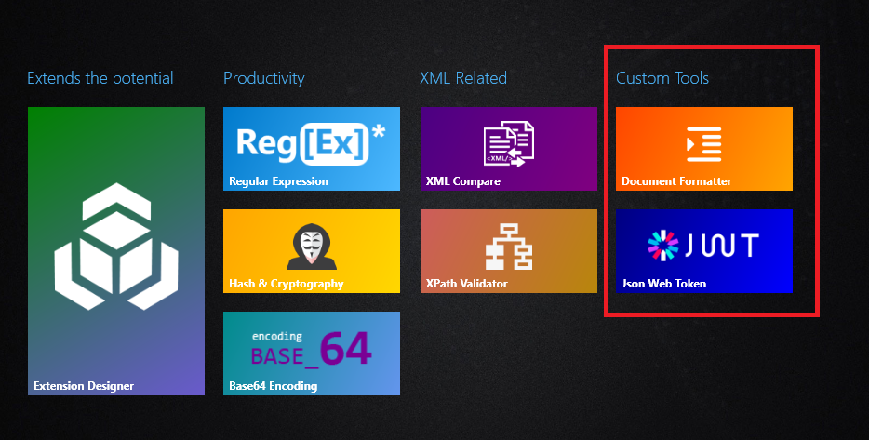
Integrated tools
Integrated tools are here to help developers and testers to run daily tasks within the software:
Regular Expression Tool
XML Compare
XPath Validator
Base 64
Hash and Cryptography
Integrated tool are also extensible !
Visit our community custom tools repository for more information

Slide 14
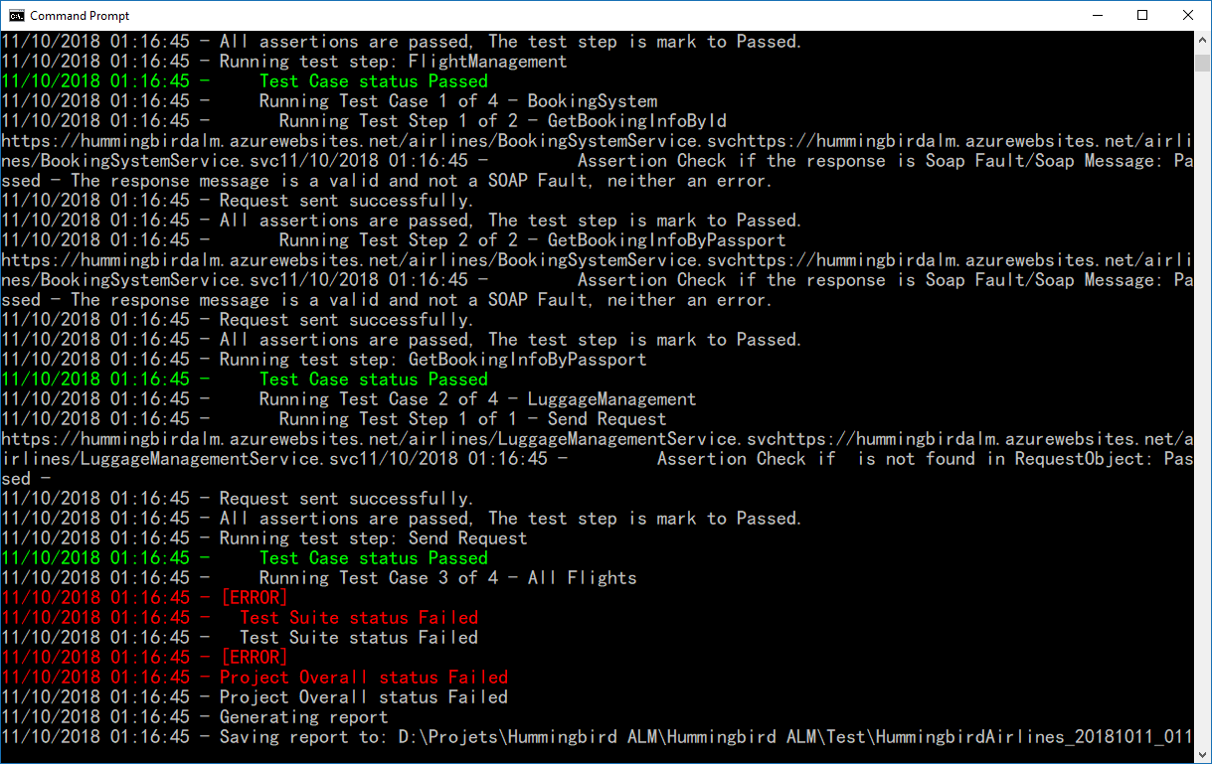


Continues integration / Continues deployment
Commit
Build
Test
Deploy
Run automated tests within your continues integration pipeline and view test results on
With Hummingbird CLI, it is also possible to integrate with other CI/CD platforms.
Azure DevOps

Slide 15
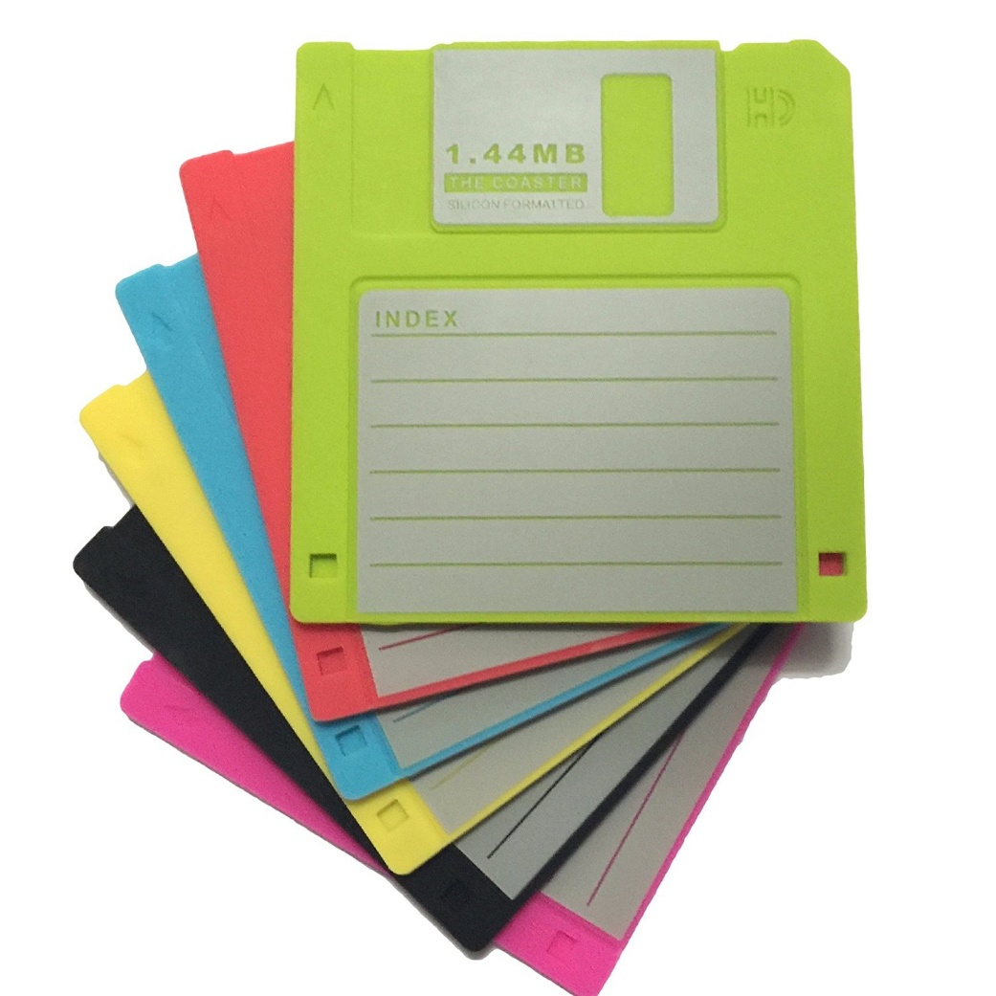
By-the-way
* Using a 4th gen of Intel Core i5 CPU
** The whole package of 2018.12 release
We understand that the quality and efficiency of the code is important.
So we are not creating another app with 100+ dependency assemblies.
The application starts in less than 3 seconds* on a 4-year-old computer
The whole package has just 7.6MB** that can even be copied on 6 floppy disks.
Hummingbird
Disk 1 of 6
Setup instructions:
Insert this disk in drive A
Type a: and press ENTER
Type setup and press ENTER

Slide 16
Resources
Useful links
For Developers
Project home page
http://www.hummingbird-alm.com
Online Help
https://huaxing-yuan.github.io/hummingbird.doc
Demo Soap services
https://hummingbirdalm.azurewebsites.net/airlines/
Test Framework SDK
NuGet package
Online Documentation
Modern UI Framework
NuGet package
Online Documentation
Extensions
SMS-C Simulation source code
LDAP Client source code

